Slide 1
Math 12 Honors:
Ch3 Review Polynomials

Slide 2
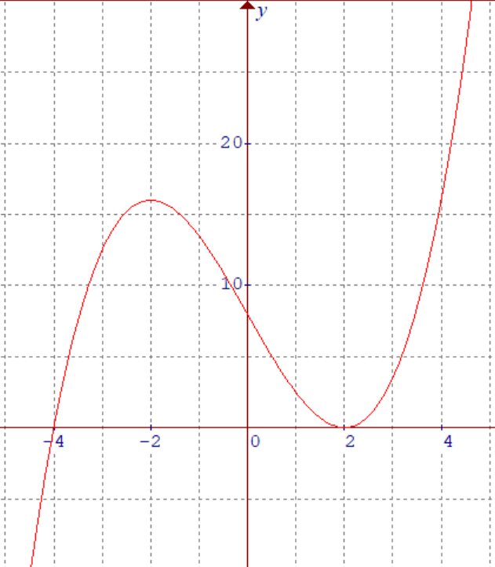
Which of the following is the correct equation for the graph below?

Slide 3
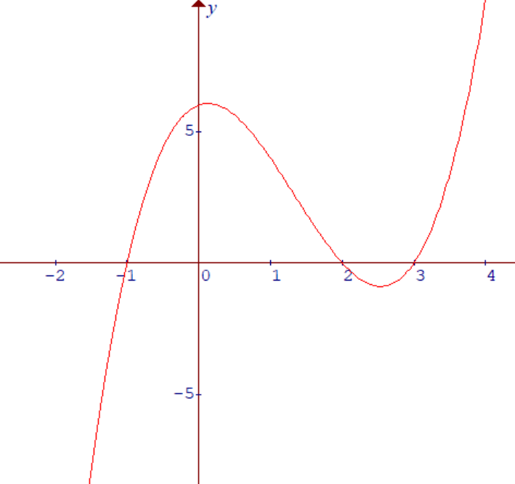

Given that the polynomial below in the form of
$y=x^{n}+{Ax}^{n−1}+$ $Bx^{n−2}+$……, what is the value of “k”?

Slide 4
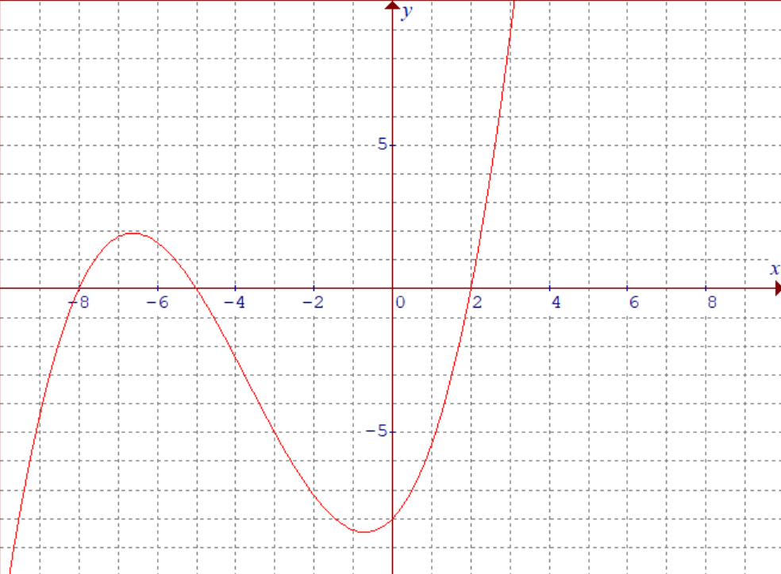
Find the equation in factored form:

Slide 6



Slide 7


Slide 8

Factor the following:
And then sketch the graph of the polynomial:

Slide 9
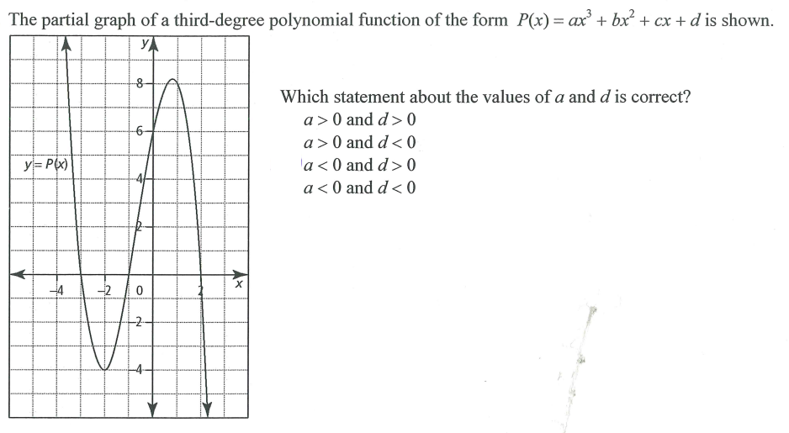

Slide 10
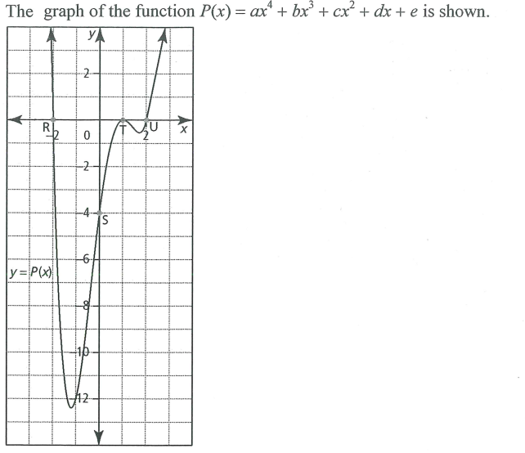

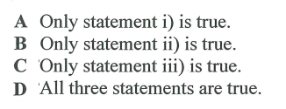
Given the statements below, which ones are correct?

Slide 11
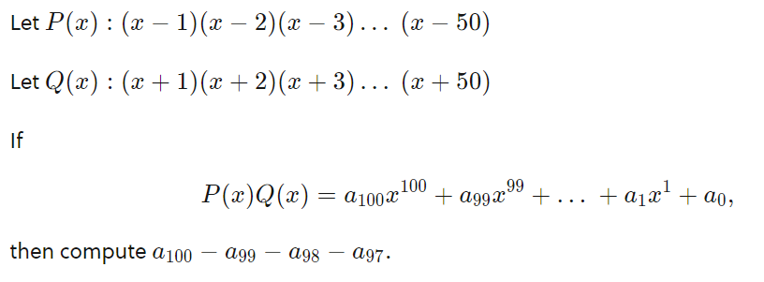

Slide 12


Slide 13
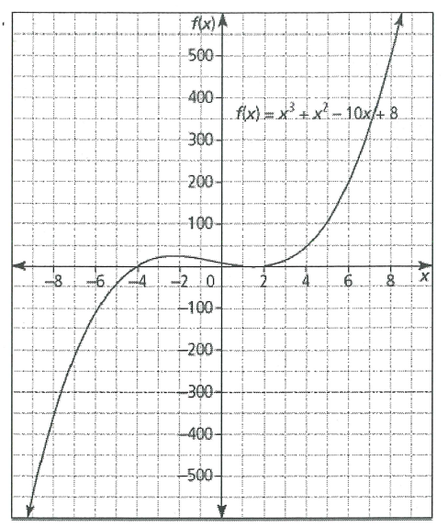
Given the function, find the following:
The X-intercepts
Y –intercept
Determine the interval for which the function is positive

Slide 15
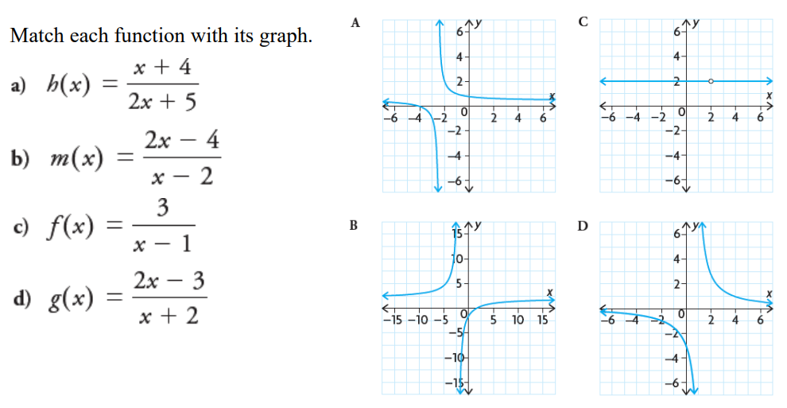

Slide 18
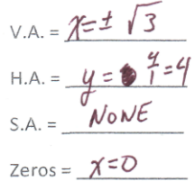
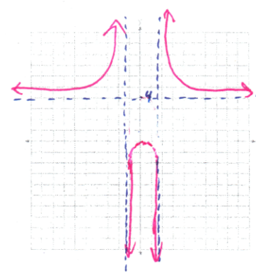
Graph the following rational function: Identify all vertical, horizontal, and slant asymptotes. Find all the roots and then graph the function:
y
8
6
4
2
0
x
-5
-4
-3
-2
-1
0
1
2
-2
-4
-6
-8

Slide 19
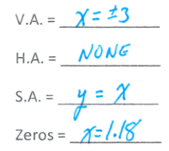
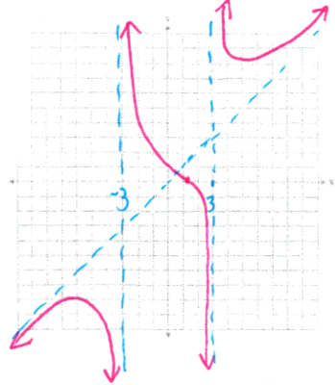
Graph the following rational function: Identify all vertical, horizontal, and slant asymptotes. Find all the roots and then graph the function:
y
8
6
4
2
0
x
-5
-4
-3
-2
-1
0
1
2
-2
-4
-6
-8

Slide 20
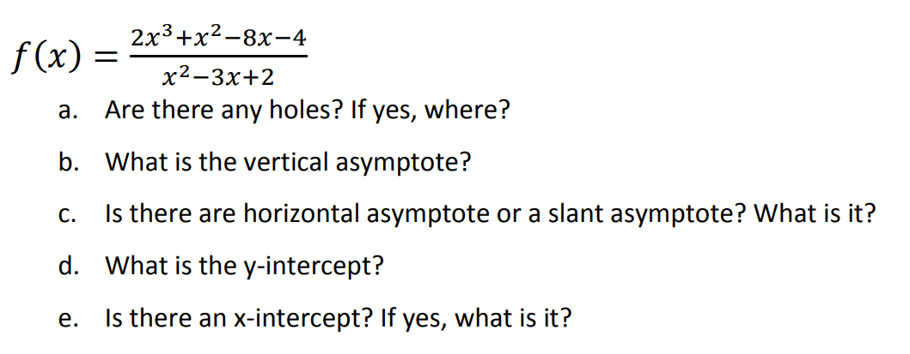


Slide 21
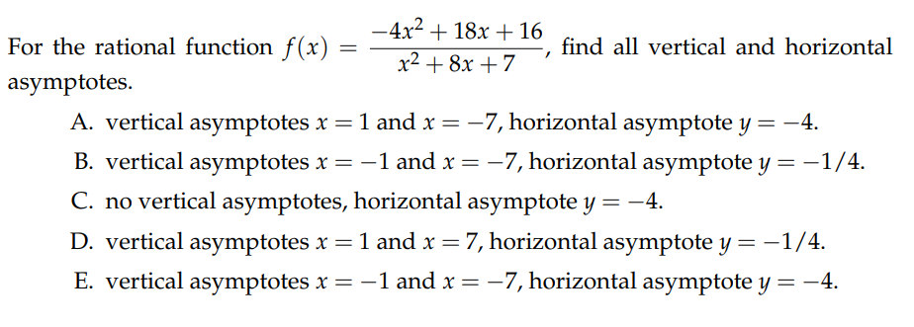

Slide 22
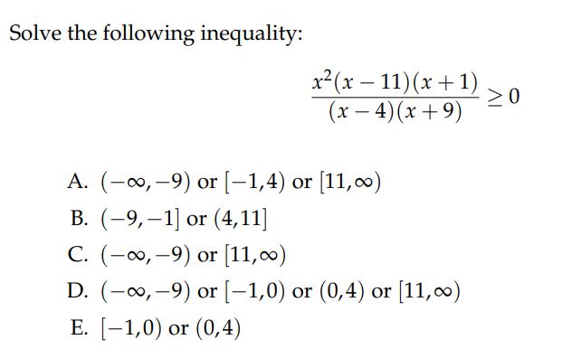

Slide 23
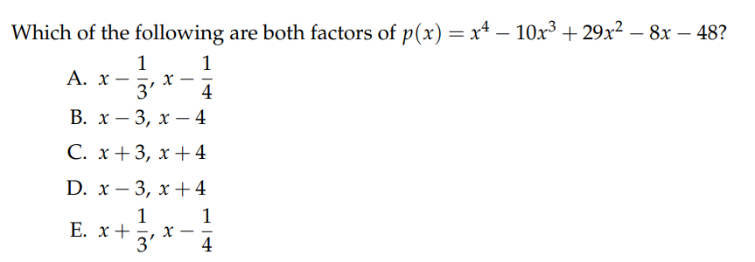

Slide 24
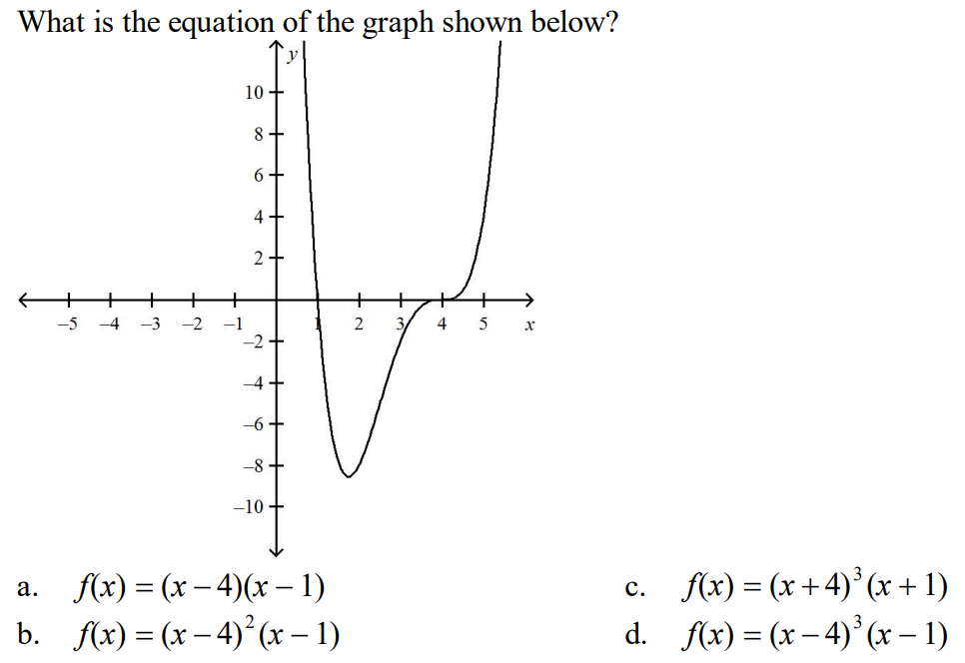

Slide 25
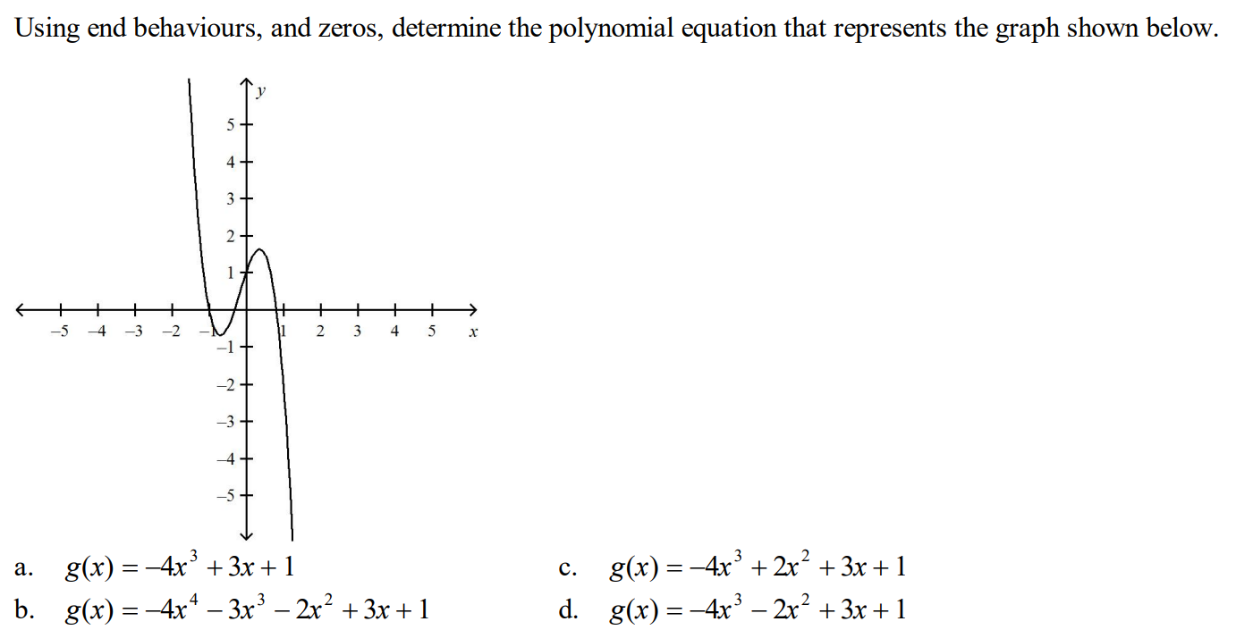

Slide 26


Slide 27
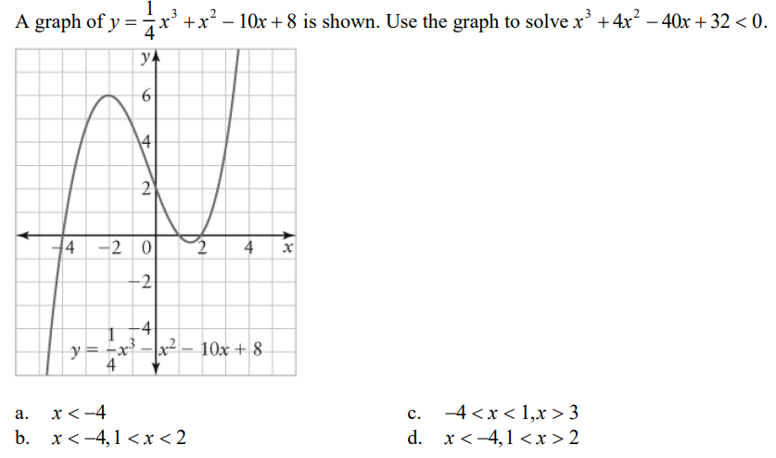

Slide 28
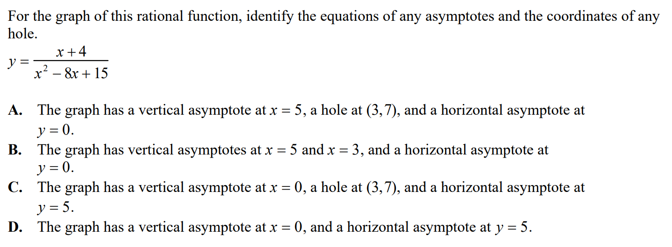

Slide 29



Slide 30

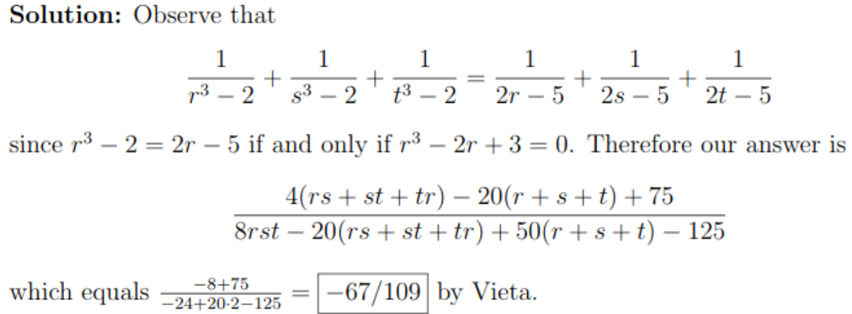

Slide 31


Slide 32

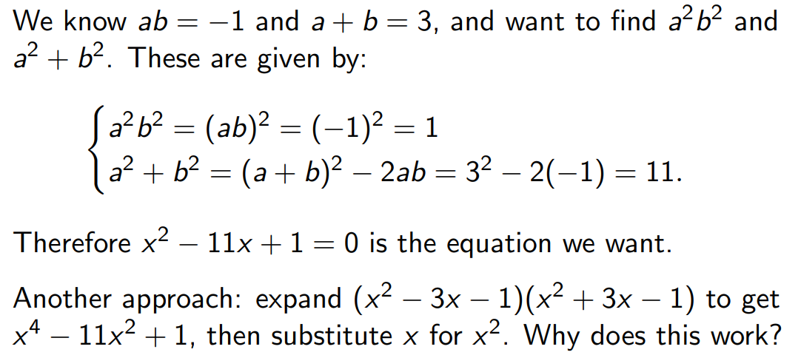

Slide 33


Slide 34



Slide 35

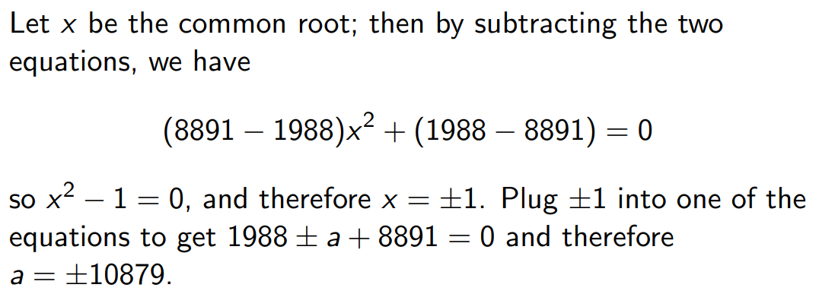

Slide 36



Slide 37


